Slide 1

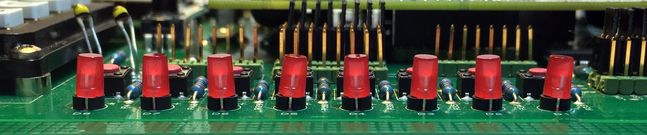
NG2H903 MEng Group Project: Propeller Clock
Martin Lewis Wynne-Jones Tendai Madhlangove-Ngoni Edward Porter David George Amin Goraine Miguel Santos

Slide 2
Propeller clock task:
Introduction
Martin Lewis Wynne-Jones
Goals
Display: Clock and user message.
Wireless communication
Basic windows app to send message
Options:
LED amount/type
Case design
PCB size
Issues:
Cost (Limited Budget)
CPU speed/com’s
Motor
Notes:
Task requested on sheet
Concept ideas
Why we picked what we wanted
Issues with what we picked and how to avoid it

Slide 3
Team Project
Martin Lewis Wynne-Jones
CLOCK DISPLAY
Edward Porter
System Housing
Martin Lewis Wynne-Jones
MAIN BODY OF PROGRAM
Amin Goraine
REPORT & ORGANISATION
Tendai Madhlangove-Ngoni
SYSTEM REPORT
David George
PCB DESIGN
Miguel Santos
Notes:
Break people into a teams. Each team has two people in it. Each person is in two different teams.
Helps with workload. Better brainstorm. Keeps things moving, even if people are sick or unable to continue with the project
Stops people waiting for someone else. Everyone is doing something or has something they can do

Slide 4
Project Management
Martin Lewis Wynne-Jones
Notes:
Here is our Gantt chart. As you can see, we’ve planned for the academic year. We understand that things may not go to plan and if so, we want to record it. With this method, we can see if we are behind or ahead of schedule and resolve the issue before it snow balls in to a much larger problem.

Slide 5
Tendai Madhlangove-Ngoni
Team Planning
TEAM ORGANISATION
First two weeks
Chose the group leader, what project: Car or clock
Full team meetings every week, each sub team has a their own meetings
First meeting challenges
Reorganisation : GitHub, and Skype, duets and whole group meetings

Slide 6
Tendai Madhlangove-Ngoni
Topic of the Meeting
Health and safety
The clock rotating speed is high hence it needs housing
The components need protection
Why Clock ?
Past project needed to be improved
Aesthetics
Safety
Benefits of the clock
Gives Information compared to an ordinary clock
Decorative
Current technology

Slide 7
Tendai Madhlangove-Ngoni
Conclusions of Meetings
1)The Schematic: (PIC, SD card, 32 RGB LEDs, Bluetooth, Sensor
2) The programme
3)The casing (housing and other mechanical parts)
4) And the Report (proposal, interim and the final Report)

Slide 8

The Project
Edward Porter

Slide 9
PCB Design
David George
PCB Design
Issues and solutions:-
Space available to place components is very limited Use of surface mount packages.
High data speeds for serial connections
Keep tracks the same length, keep the runs as straight as possible.
High use of available board space
Enlarge the board as far as possible
Use the smallest possible tracking

Slide 10
Components
David George
Component Selection
LED’s
Surface mount RGB
Low cost £0.24
Small foot print 3mm or 5mm
Small display size
Complex PCB tracking
Close packing possible
Through hole RGB
High cost £2.12
Large foot print 5 or 10mm diameter
Larger display size
Easy PCB tracking
Not easy to get packing close.
LED Driver
Considerations, Drive capability (suitable to drive possible range of appropriate LED’s)
Shift Register
Available in surface mount or through hole
Cheaper
Doesn't control LED current
Limited drive current
One bit per led
No colour correction
LED Driver
Available surface mount or through hole
More expensive but controls more LED’s per chip
Controls LED Current and reports faults
Selectable drive current from 5mA to 80mA
12 bit grey scale led brightness per led
6 bit colour correction

Slide 11
CPU
David George
Processor Core
Processor Selection During the project the processor specification has developed with an understanding of what will be required. Initially a PIC 16 20MHz with few features one serial port 8 bit bussing Final speciation ARM M4 198MHz core with several serial ports 32 bit bussing

Slide 12
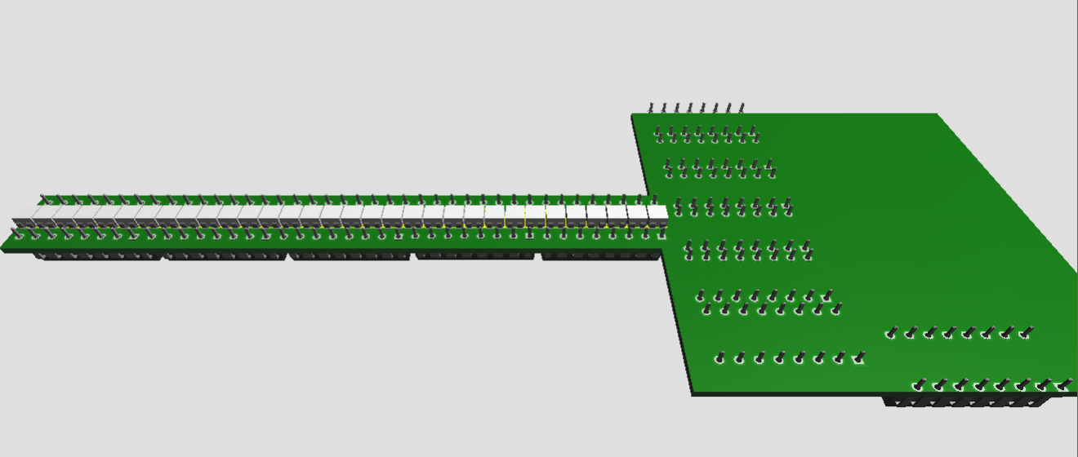
Design
David George
Initial design
Entire board space consumed with shift registers to drive LED’s

Slide 13
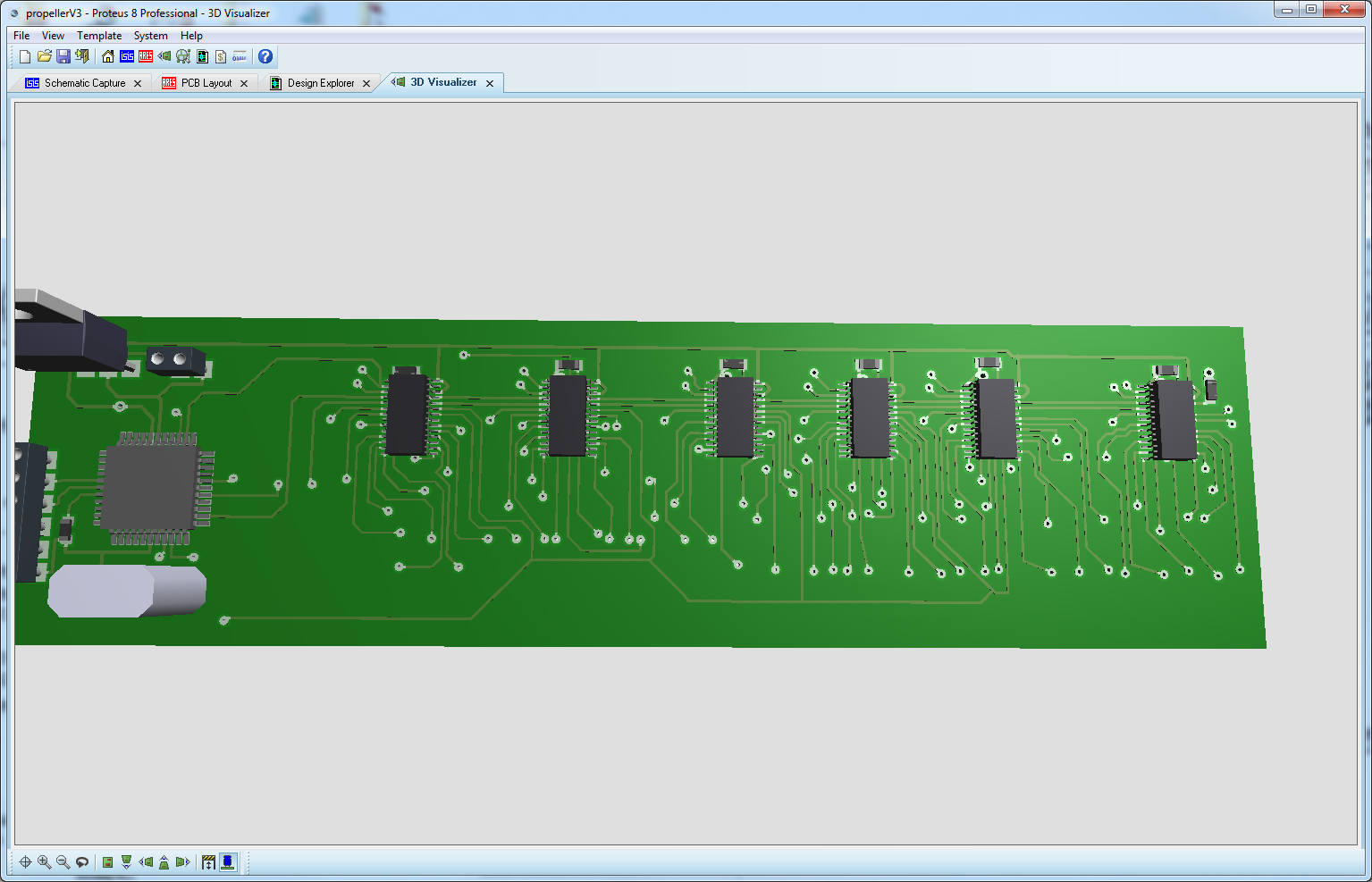
Later PCB design
Design Development
David George
Surface mount LED drivers, with smallest available tracks used.

Slide 14
Image Layout
The Project
Amin Goraine
32 colour LEDs
36 bit per pixel(12 bits per colour)
144 bytes per segment
≈10k Bytes per image
Stored as 2D array
R
G
B
…
R
G
B
R
G
B
R
G
B
R
G
B
…
R
G
B
12
24
36
48
60
72
1096
1128
1140
1152

Slide 15
Displaying the image
The Project
Amin Goraine
Memory
DMA
A new segment(144 bytes) is updated every 0.46mS
Only viable way is using timer interrupts
To minimise time spent in interrupts we use DMA to SPI
75MHz
APB2
peripheral
42MHz
SPI
30MHz
LED
driver

Slide 16
Clock animation
The Project
Amin Goraine
Interrupts can’t be disabled
Clock animation needs to be interrupt safe
Clock Image Buffer 1
Clock Image Buffer 2
Buffer to be drawn
*
*
Buffer to be updated
*
len
bShould
Swap
*
len
Temp Buffer
Temp Buffer
rotation
rotation
Clock handle animation data

Slide 17
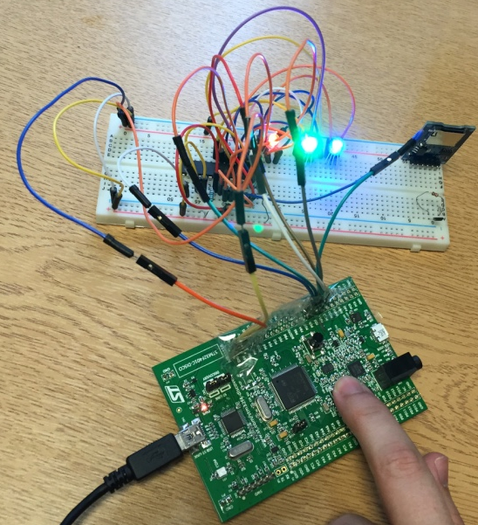
Prototype Demo
Miguel Santos

